Slide 1
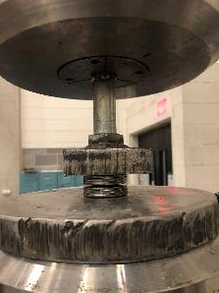
Material Testing
Machine
Loading
plates
K1875-G-086
2 units of 2U2D

Slide 2
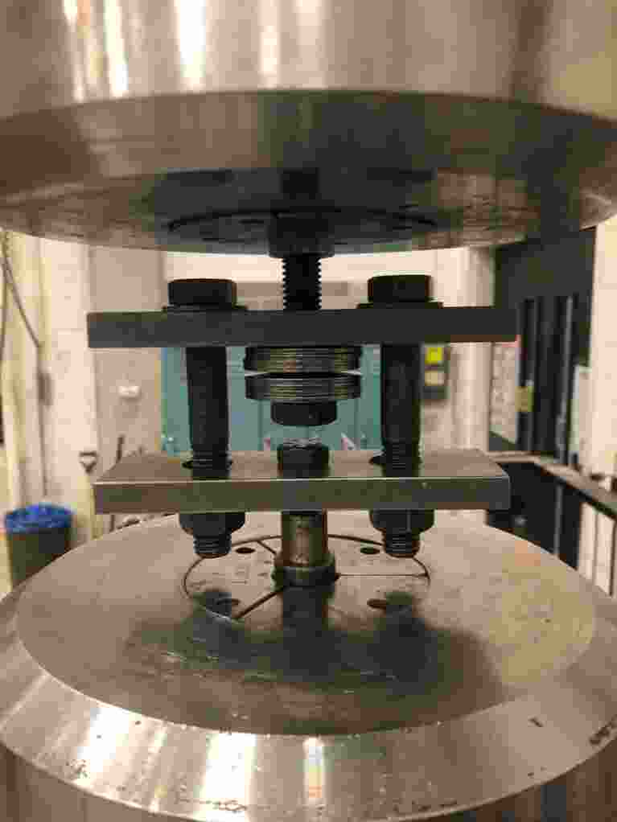
Material testing
Machine grip
Guide rod
K1875-G-086
2 units of 2U2D
Loading
frame
Material testing
Machine grip

Slide 3
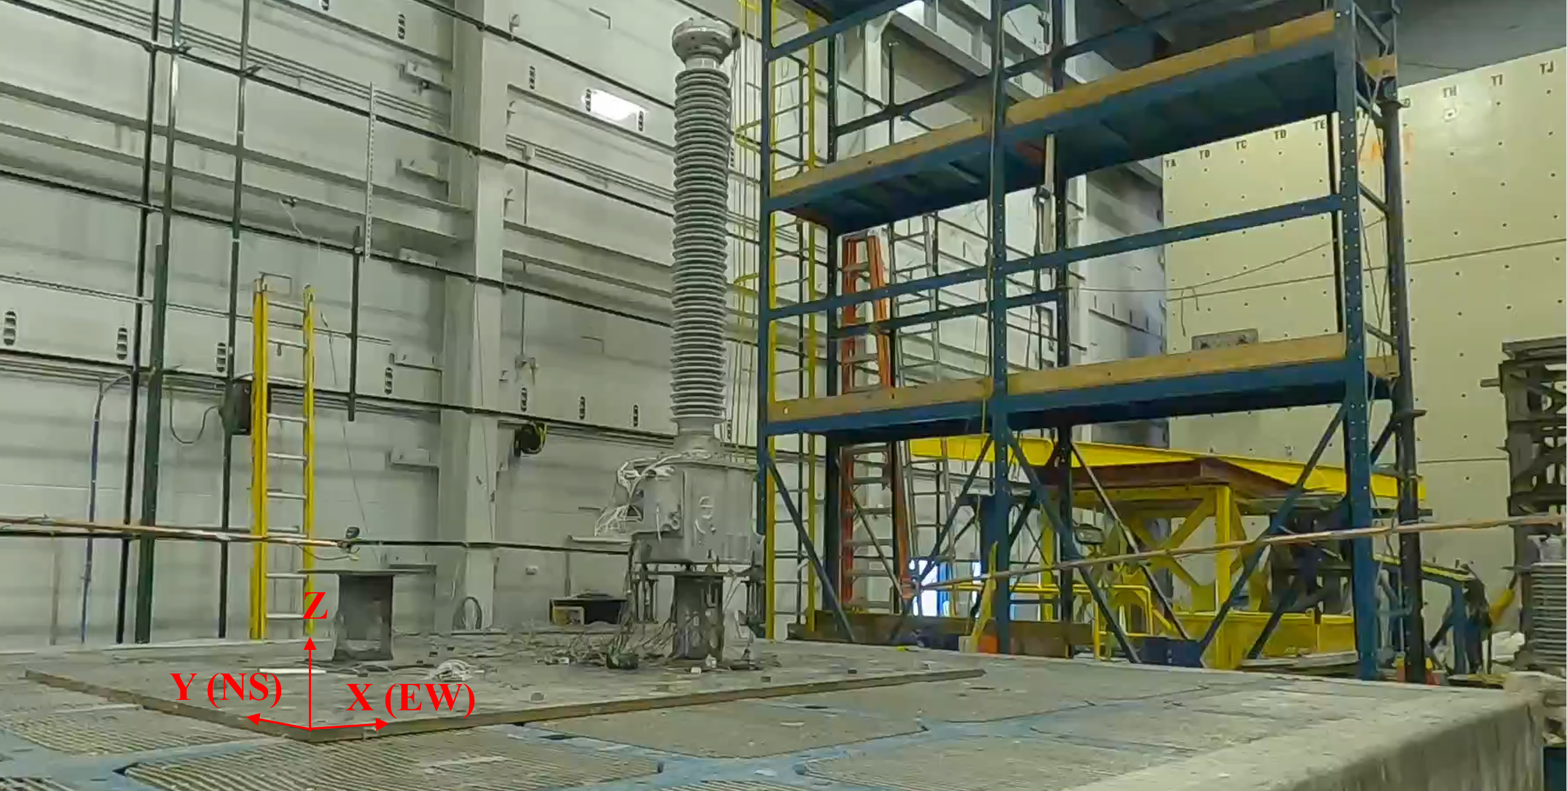
CVT
Belleville washers
Spool
Shake table

Slide 4
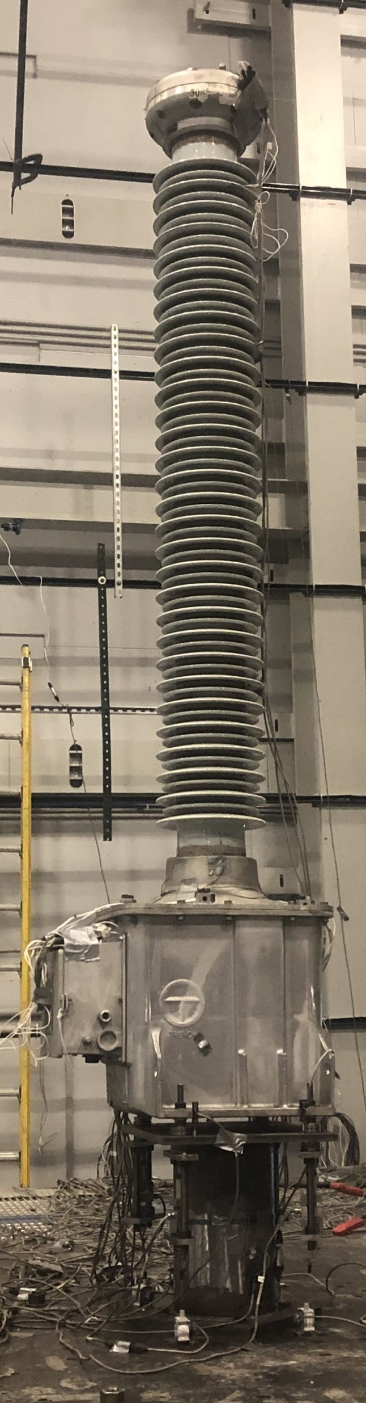
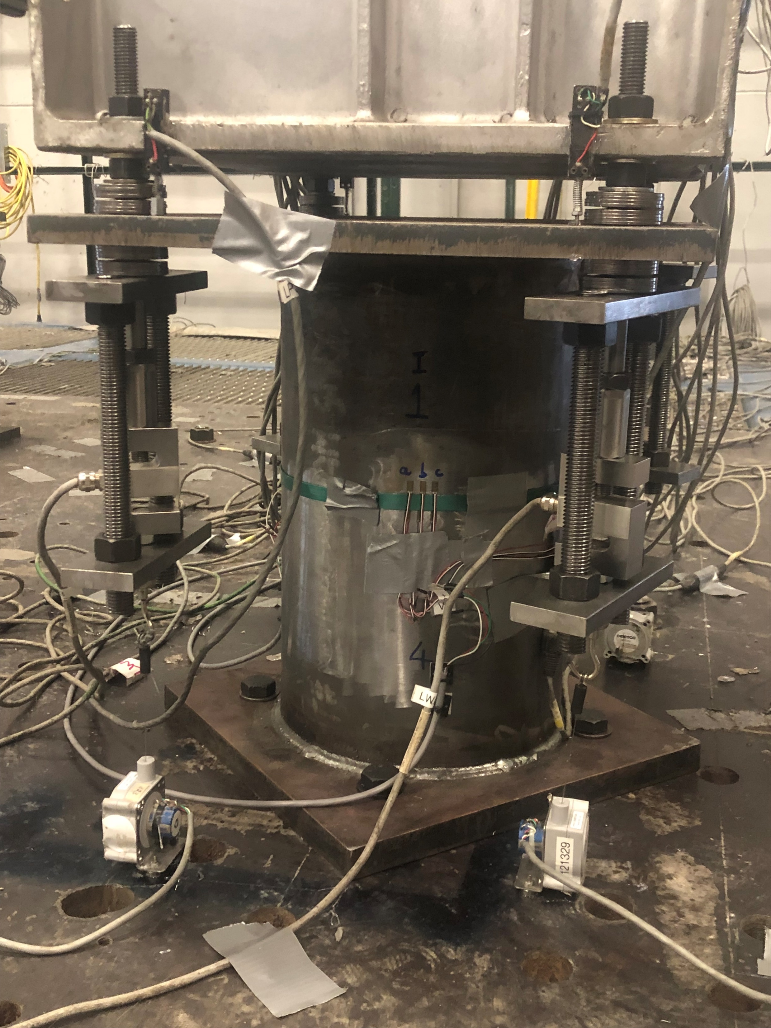
Top acceleration
and displacement, X and Y
Mid acceleration, X and Y
Top stack deformation
Strains at Bushing base
N, S, E and W
4 LWAs, each corner
Moment, X and Y
CVT box acceleration, Z
in N, S, E and W
Z
Spool
Y
X
Z
Y
X

Slide 5
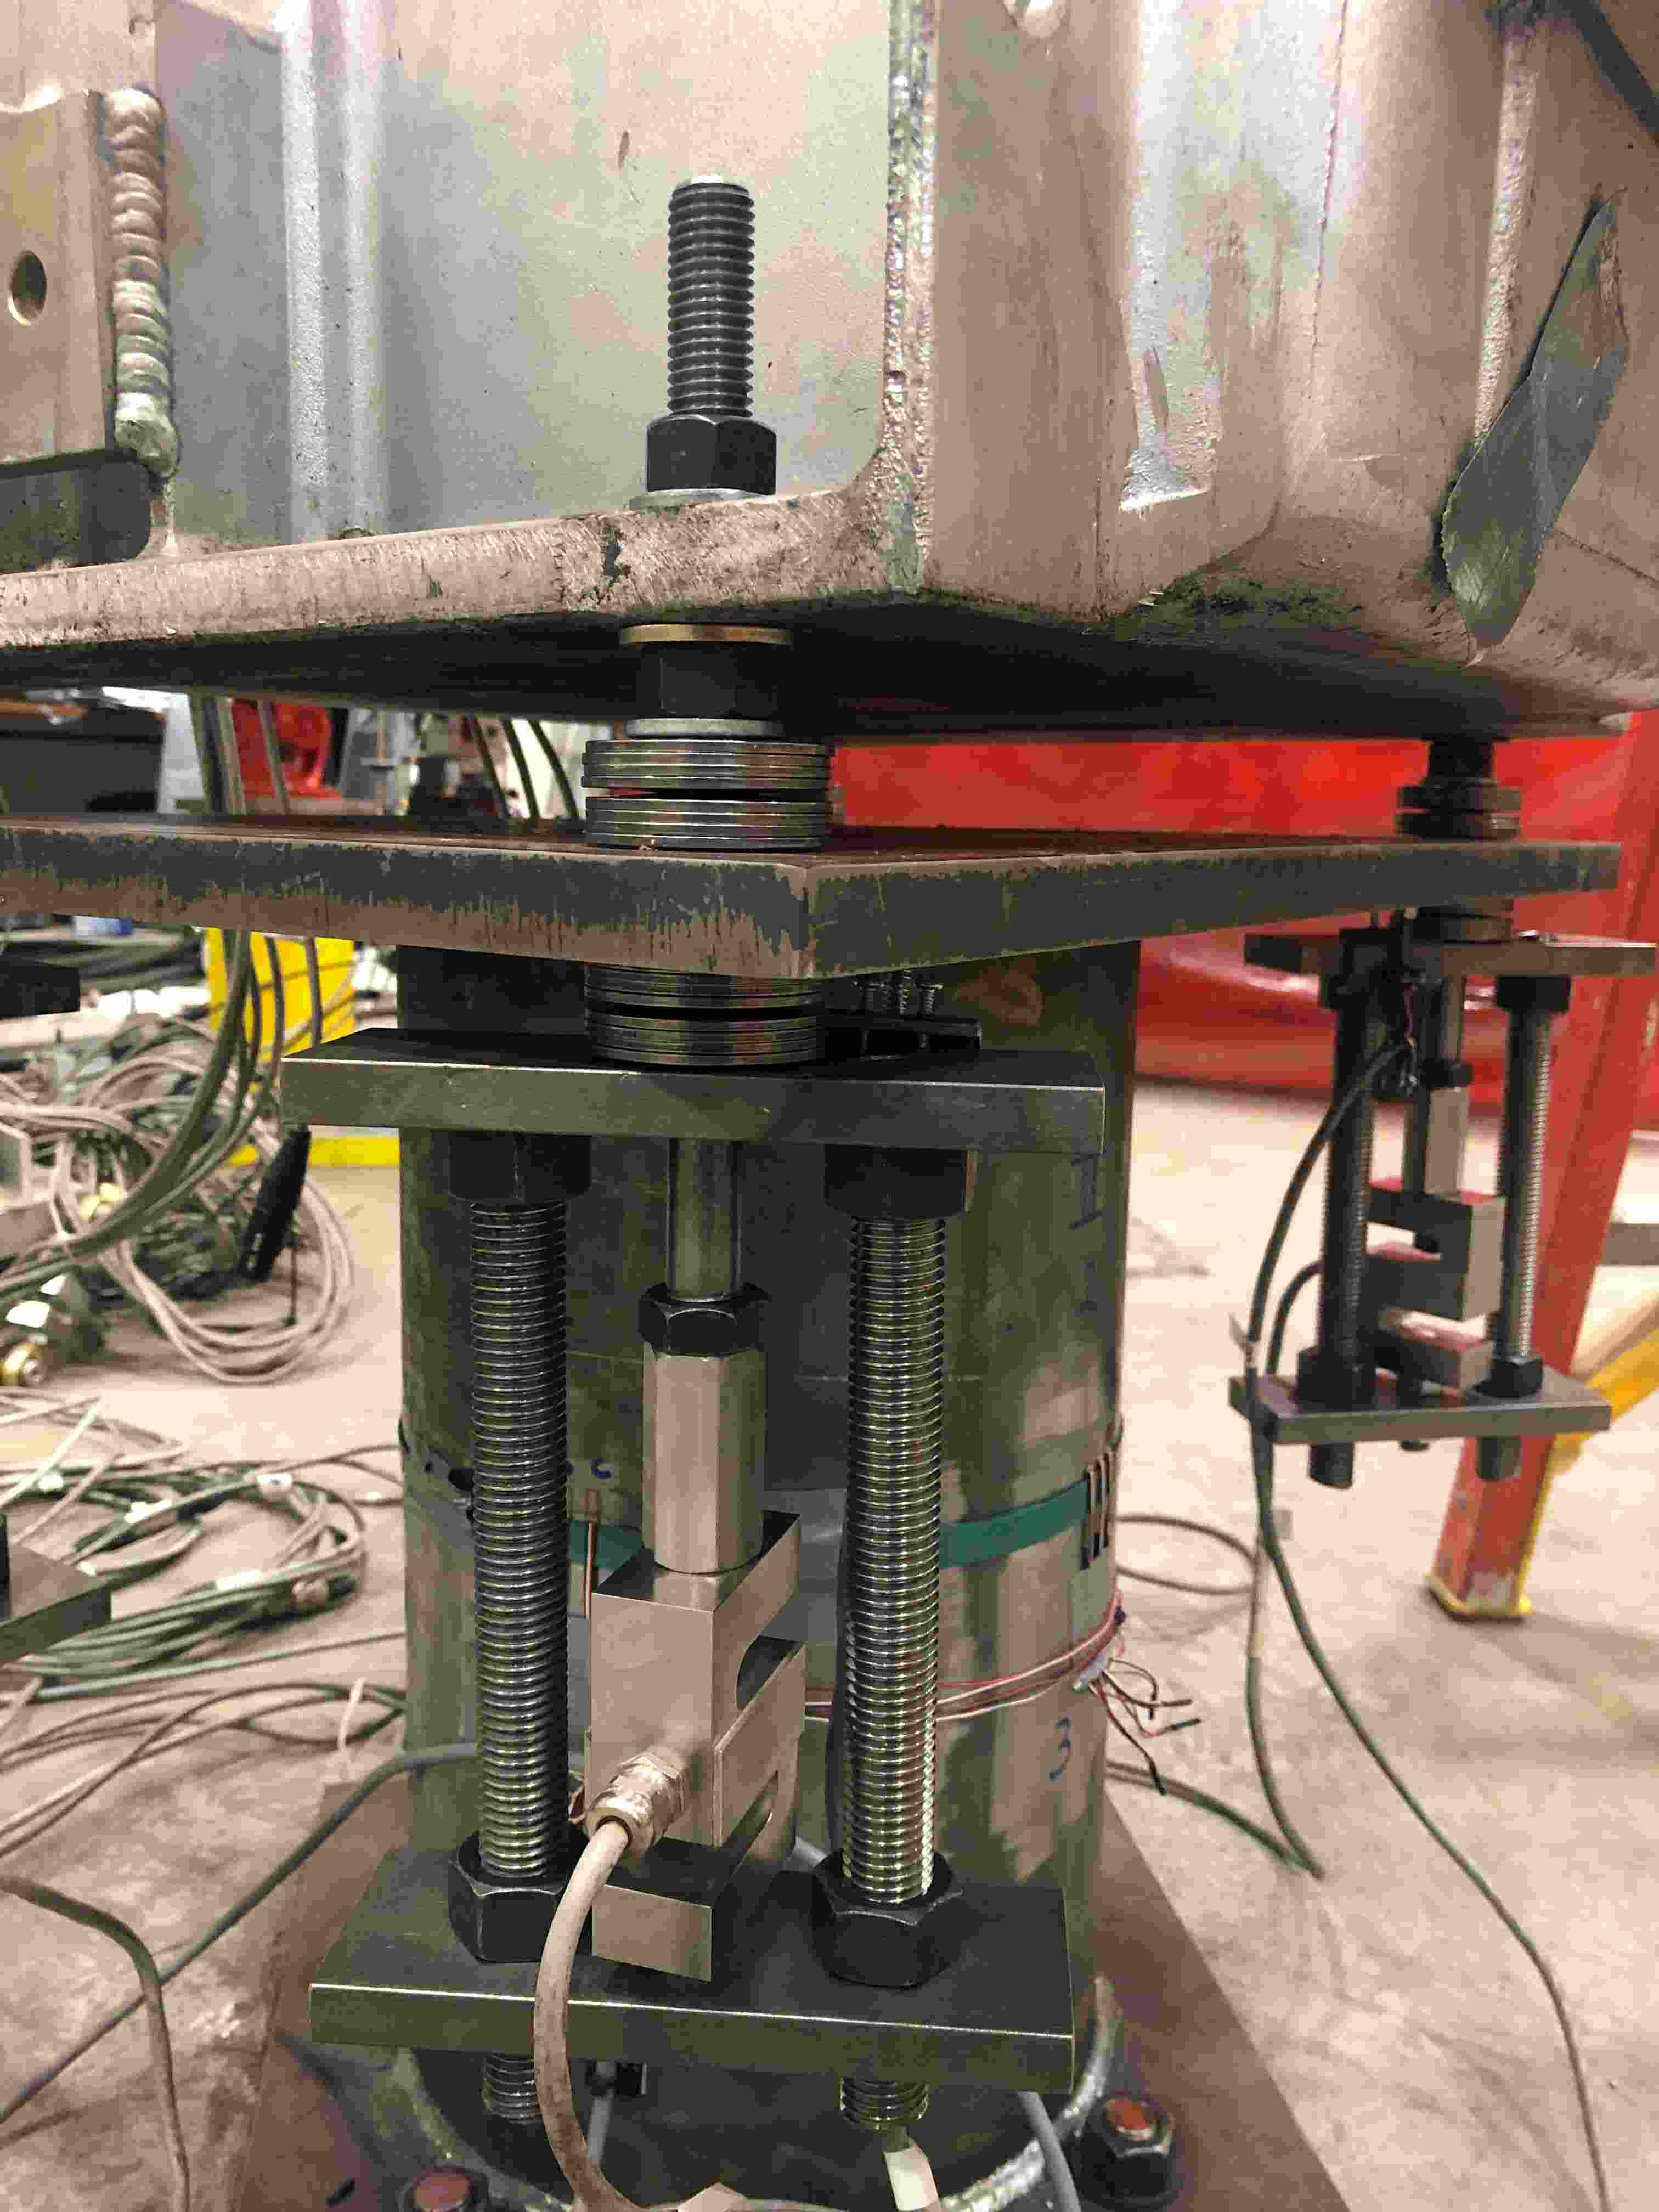
Z
Nut used to apply preload
Y (NS)
Spool top plate
X (EW)
K1875 2 units of 2U2D
Spool
3/4in rods to complete load path
Load cell

Slide 6
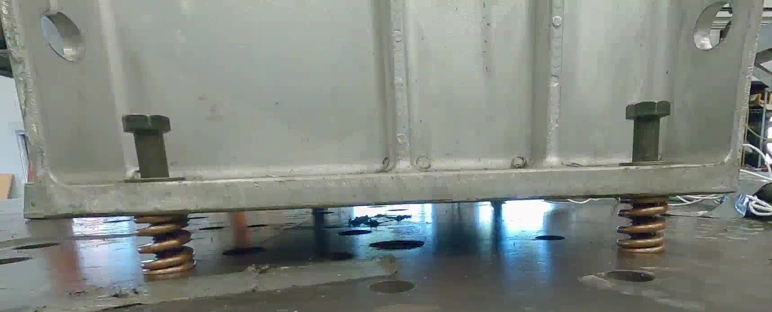
CVT base
Guide bolt
2,120 lb/in springs
at four corners
Floor

Slide 7

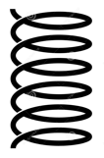
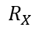
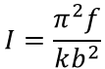
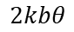
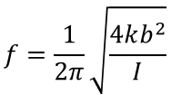
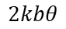
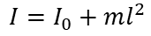
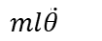
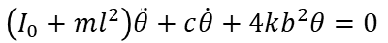
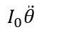
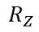
θ
Free body diagram
Center of mass
$$ml\ddot{θ}$$
$$I_{0}\ddot{θ}$$
l
b
b
Center of rotation
k
k
$$R_{X}$$
$$2kbθ$$
$$R_{Z}$$
$$2kbθ$$
Equation of motion:
$$\left(I_{0}+ml^{2}\right)\ddot{θ}+c\dot{θ}+4kb^{2}θ=0$$
Mass moment of inertia about center of rotation:
$$I=I_{0}+ml^{2}$$
$$f=\frac{1}{2π}\sqrt{\frac{4kb^{2}}{I}}$$
$$I=\frac{π^{2}f}{kb^{2}}$$
Frequency,
from which

Slide 8
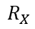
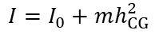
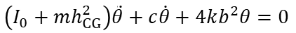
θ
Free body diagram
Center of mass
$$ml\ddot{θ}$$
$$I_{0}\ddot{θ}$$
h_{CG}
b
b
$$R_{X}$$
$$R_{Z}$$
k
k
$$2kbθ$$
$$2kbθ$$
Equation of motion:
$$\left(I_{0}+mh_{CG}^{2}\right)\ddot{θ}+c\dot{θ}+4kb^{2}θ=0$$
Mass moment of inertia about center of rotation:
$$I=I_{0}+mh_{CG}^{2}$$
$$f=\frac{1}{2π}\sqrt{\frac{4kb^{2}}{I}}$$
$$I=\frac{π^{2}f}{kb^{2}}$$
Frequency,
from which

Slide 9

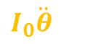

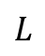
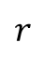
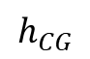
Cut is at mid-spool
$$I_{0}\ddot{θ}$$
$$m{\ddot{x}}_{t}$$
$$mg+m{\ddot{z}}_{t}$$
$$h_{CG}$$
Z
Z
Y
X
Y
X
$$L$$
$$r$$
R
V
LWA
2
LWA
1
LWA
2
LWA
1
M_{spool}

Slide 10
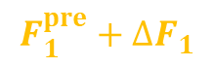
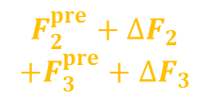
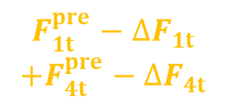
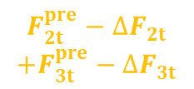
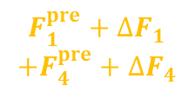
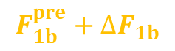
Cut 2 is at mid-spool and CVT base
$${F_{2t}^{pre}−∆F}_{2t}$$
$$+{F_{3t}^{pre}−∆F}_{3t}$$
$${F_{1t}^{pre}−∆F}_{1t}$$
$$+{F_{4t}^{pre}−∆F}_{4t}$$
Z
$${F_{2}^{pre}+∆F}_{2}$$
$$+{F_{3}^{pre}+∆F}_{3}$$
$${F_{1}^{pre}+∆F}_{1}$$
$$+{F_{4}^{pre}+∆F}_{4}$$
O
Y
X
V₁
V₂
R
r
LWA
2, 3
V
LWA
1, 4
Z
M_{spool}
_{b}
_{b}
Y
X
Cut 3 is above LWA1
$${F_{1b}^{pre}+∆F}_{1b}$$
$${F_{1}^{pre}+∆F}_{1}$$
Cut 2
Cut 3
LWA
2
LWA
1
LWA
1

Slide 11


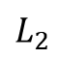
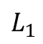

Cut 4 is at insulator base
$$I_{0ins}\ddot{θ}$$
$$m_{ins}{\ddot{x}}_{t,ins}$$
$$m_{ins}g+m{\ddot{z}}_{t}$$
$$L_{1}$$
R_{ins}
$$L_{2}$$
Z
M_{ins}
V_{ins}
Y
X
O
O
Cut 3
LWA
2
LWA
1

Slide 12
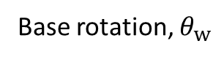
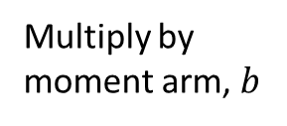
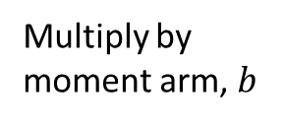
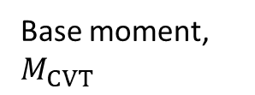
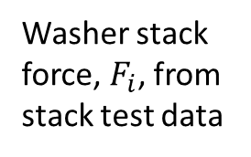
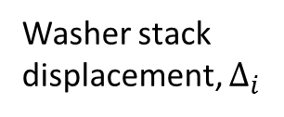
Washer stack force, $F_{i}$, from stack test data
Multiply by moment arm, $b$
Washer stack displacement, $Δ_{i}$
Multiply by moment arm, $b$
Base moment, $M_{CVT}$
Base rotation, $θ_{w}$

Slide 13
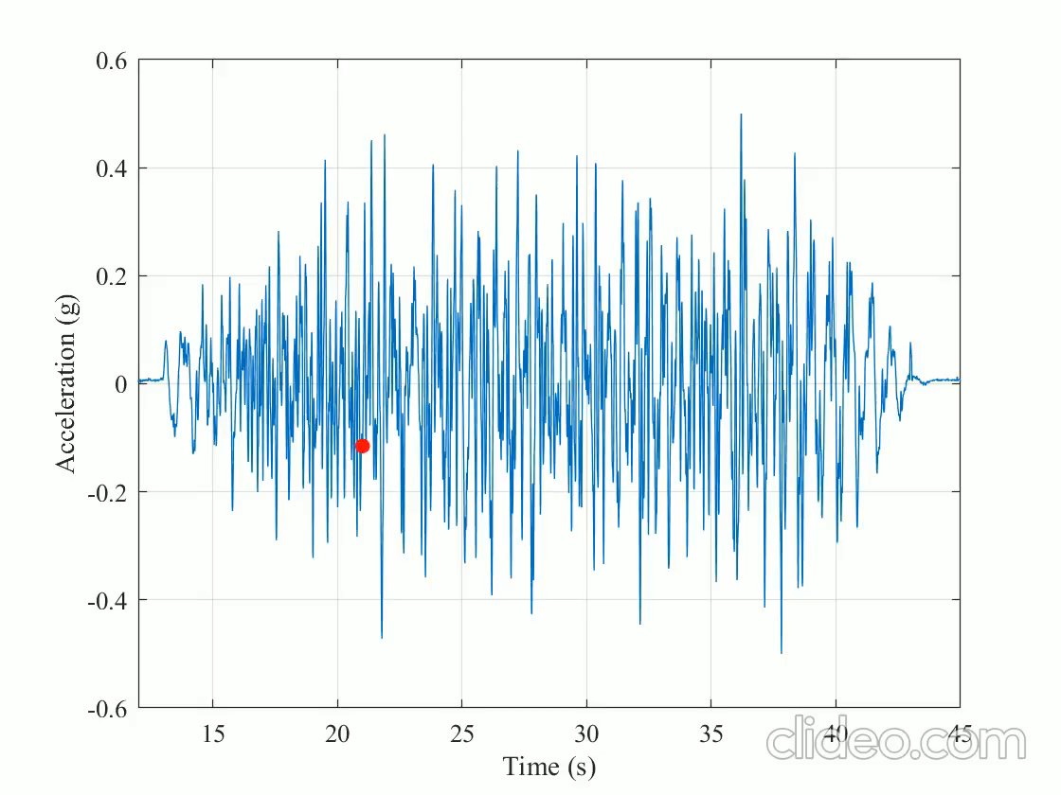
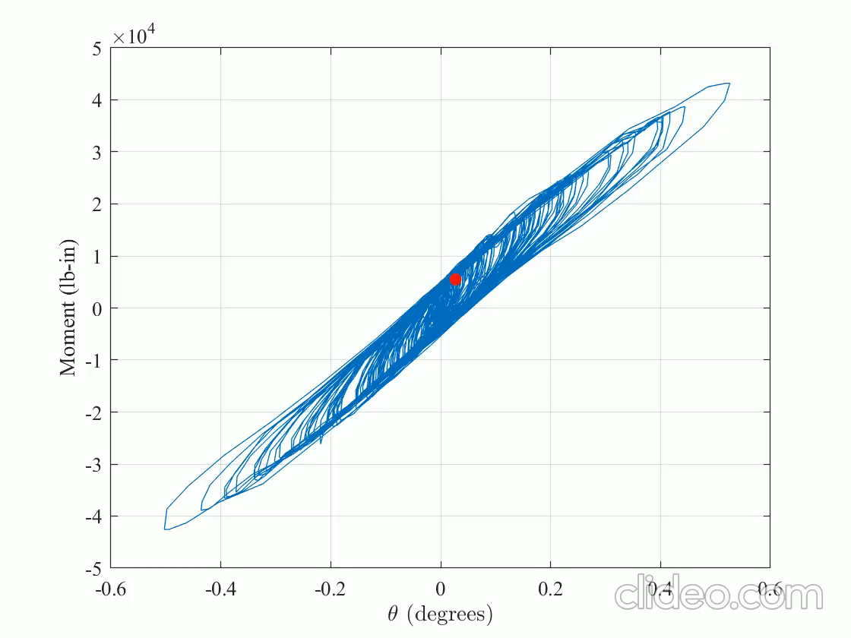
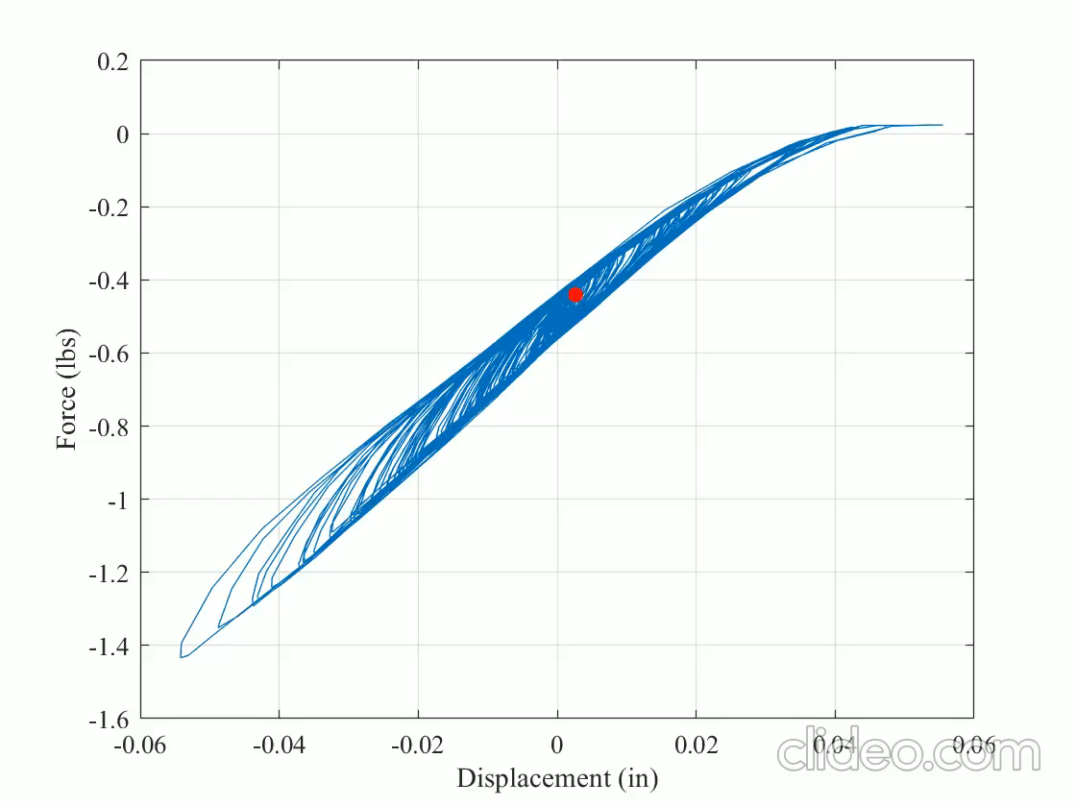
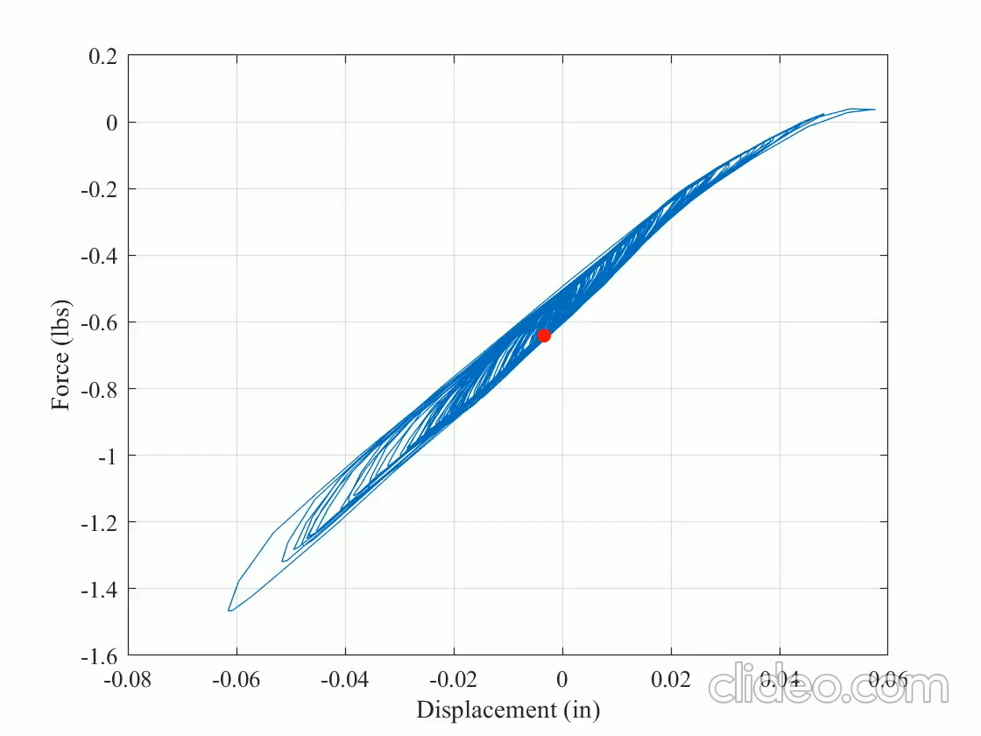
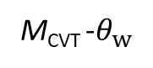
Shake table acceleration
M_{CVT} -$θ_{w}$
w
LWA1 OR LWA4:
Force-displacement
LWA2 OR LWA3:
Force-displacement

Slide 14
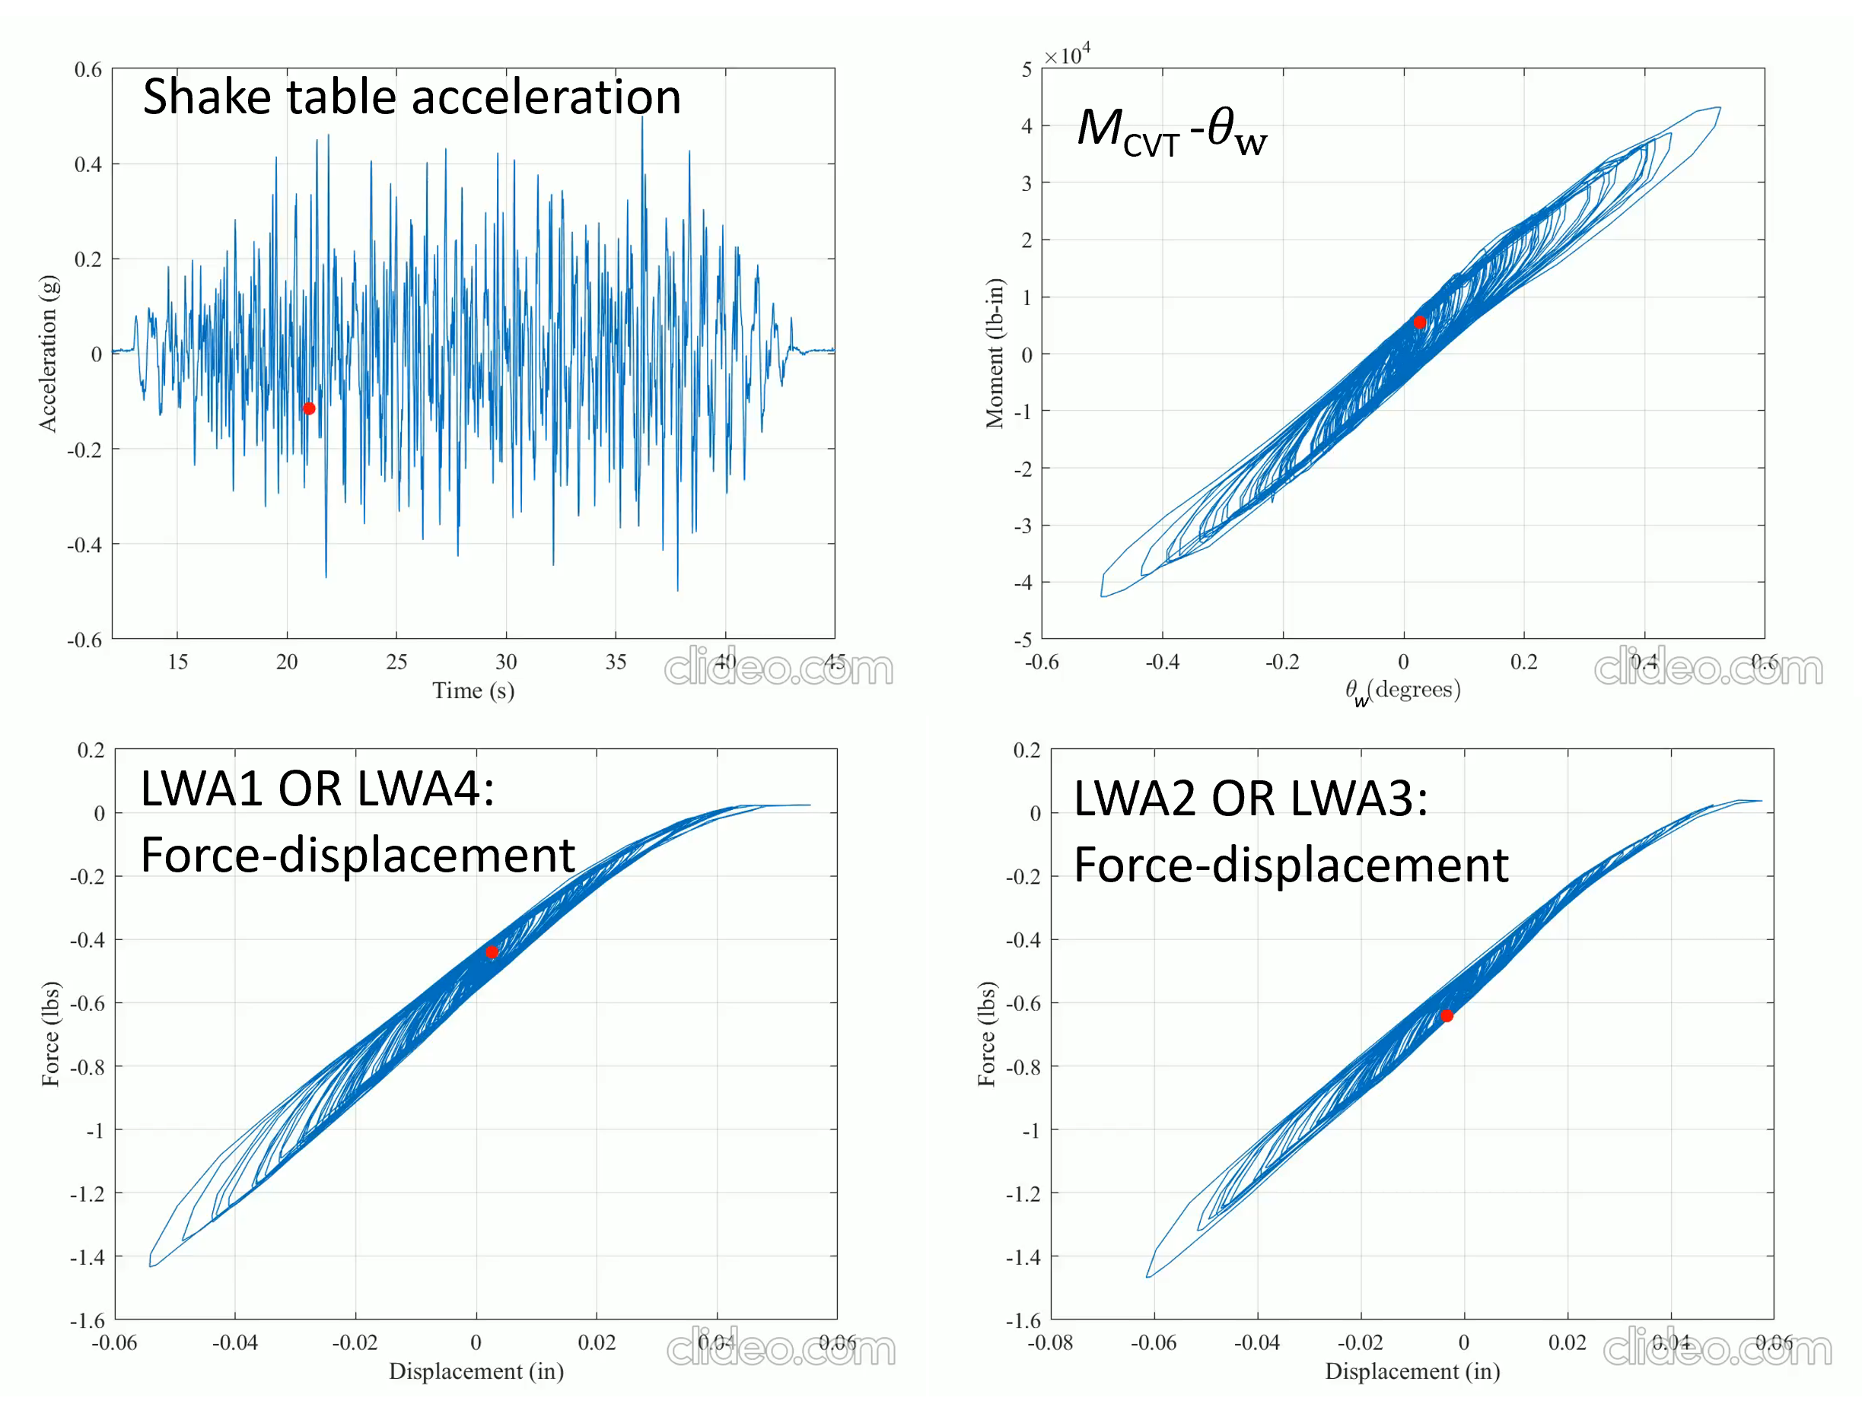

Slide 15
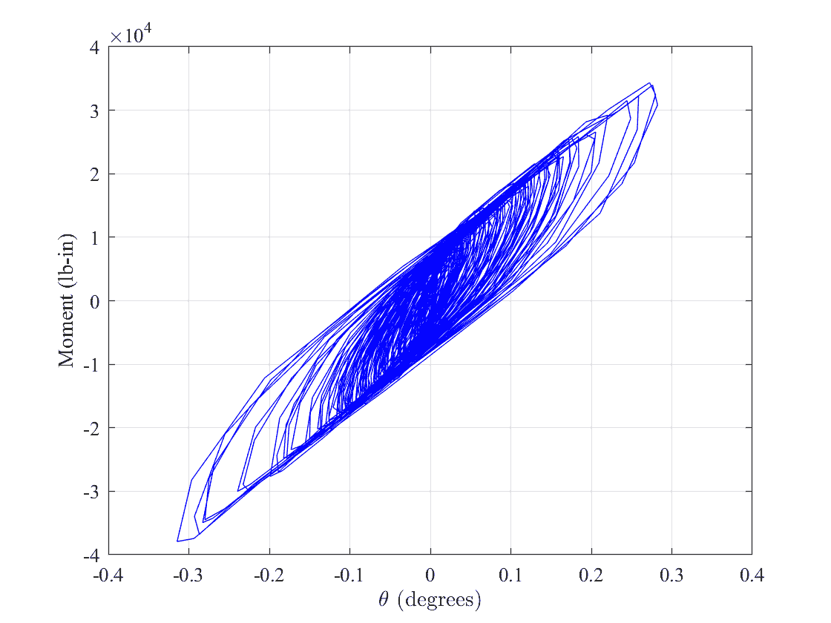
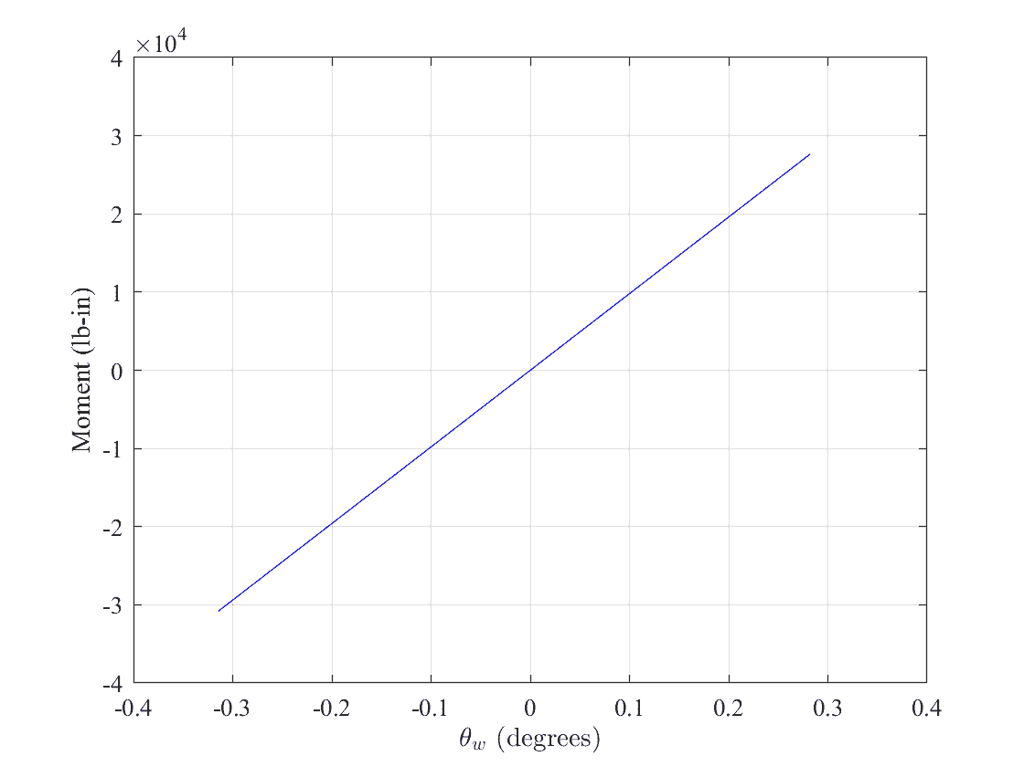
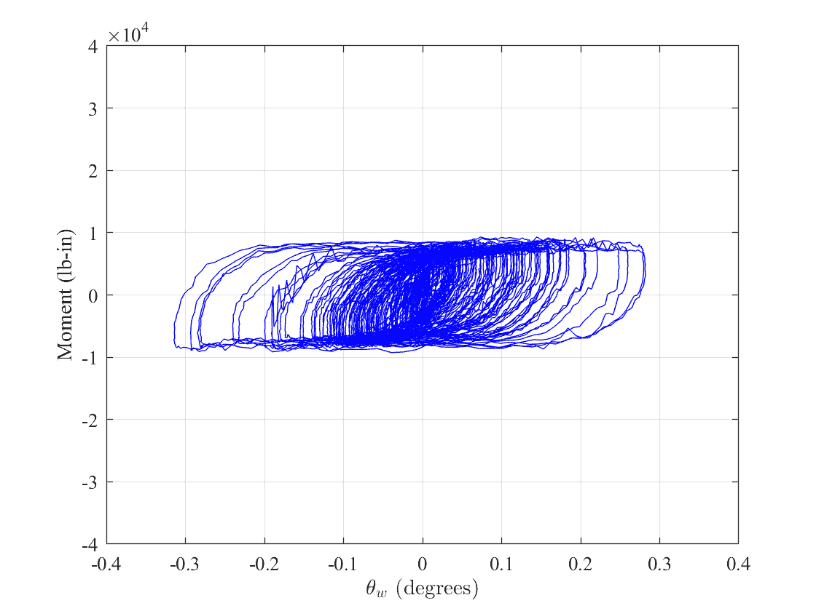
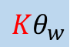
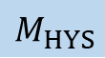


0.5g CERL EW
Double acting K1875
2 units of 2U2D
1000lbs preload
$$M_{CVT}$$
$$Kθ_{w}$$
$$M_{HYS}$$
w
$$M_{CVT}=M+Kθ_{w}$$
$$\dot{M}=k\left(1−H_{1}H_{2}\right){\dot{θ}}_{w}$$
$$H_{1}={\left|\frac{M}{M_{y}}\right|}^{N}$$
$$H_{2}=η+\left(1−η\right)sgn⁡(M{\dot{θ}}_{w})$$

Slide 16







0.5g CERL EW
Double acting K1875
2 units of 2U2D
500lbs preload
$$M_{CVT}$$
$$Ktanh⁡(αθ_{w})$$
$$M_{HYS}$$
w
$$M_{CVT}=M+k_{1}tanh⁡(k_{2}θ_{w})$$
$$\dot{M}=k\left(1−H_{1}H_{2}\right){\dot{θ}}_{w}$$
$$H_{1}={\left|\frac{M}{M_{y}}\right|}^{N}$$
$$H_{2}=η+\left(1−η\right)sgn⁡(M{\dot{θ}}_{w})$$

Slide 17










0.5g CERL EW
Double acting K1875
2 units of 2U2D
Parameter | Value
K | 5.6×10⁶ lb-in
k | 4×10⁷ lb-in
M_{yield} | 8200 lb-in
N | 0.2
$$η$$ | 0.5
1000lbs preload
$$M_{CVT}$$
$$M_{HYS}$$
w
w
Parameter | Value
K | 5.8×10⁴ lb-in
α | 92
k | 4.4×10⁷ lb-in
M_{yield} | 5000 lb-in
N | 0.2
$$η$$ | 0.5
500lbs preload
$$M_{CVT}$$
$$M_{HYS}$$
w
w

Slide 18










0.5g CERL EW
$$θ_{t}=θ_{w}+θ_{p}$$
Double acting K1875
2 units of 2U2D
0% preload
25% preload
50% preload
$$θ$$
$$θ_{w}$$
$$θ_{p}$$

Slide 19









M_{CVT}
M_{CVT}
$$θ_{w}$$
M_{ins}
$$θ$$
$$θ_{p}$$
500lbs preload

Slide 20





M_{CVT}
M_{CVT}
$$θ_{w}$$
M_{ins}
$$θ$$
$$θ_{p}$$
500lbs preload

Slide 21


















3. Modeling moment-rotation – equivalent stiffness and damping ratio
Double acting K1875
2 units of 2U2D
500lbs preload
$$f_{D}$$
$$f_{S}$$
$$f_{I}$$
m
$$p_{o}sin⁡(ωt)$$
M_{CVT}
$$f_{S}+ f_{D}$$
$$c\dot{u}$$
$$ku$$
$$m\ddot{u}$$
$$f_{S}=ku$$
$$f_{S}+ f_{D}+ f_{I}=p_{o}sin⁡(ωt)$$
$$ku_{0}$$
$$m\ddot{u}+c\dot{u}+ku=p_{o}sin⁡(ωt)$$
$$u$$
$$m\ddot{u}+2ζω\dot{u}+ω^{2}u=\frac{p_{o}sin⁡(ωt)}{m}$$
$$u_{0}$$
w
$$A_{h}$$
$$2πζk{u_{0}}^{2}$$

Slide 22





3. Modeling moment-rotation – equivalent stiffness and damping ratio
Double acting K1875
2 units of 2U2D
500lbs preload
$$f_{D}$$
$$f_{S}$$
$$f_{I}$$
m
$$p_{o}sin⁡(ωt)$$
M_{CVT}
$$f_{S}+ f_{D}$$
$$c\dot{u}$$
$$ku$$
$$m\ddot{u}$$
$$ku_{0}$$
$$f_{S}=ku$$
$$f_{S}+ f_{D}+ f_{I}=p_{o}sin⁡(ωt)$$
$$ku_{0}$$
$$m\ddot{u}+c\dot{u}+ku=p_{o}sin⁡(ωt)$$
$$u$$
$$u_{0}$$
$$m\ddot{u}+2ζω\dot{u}+ω^{2}u=\frac{p_{o}sin⁡(ωt)}{m}$$
$$u_{0}$$
Parameter | Formula | Comment
k (lb-in/rad) | - | Equivalent stiffness
f (Hz) | $$\frac{1}{2π}\sqrt{\frac{k}{I_{0}+m{h_{CG}}^{2}}}$$ | Equivalent natural frequency
$ζ$ (%) | $$\frac{A_{h}}{2πk{u_{0}}^{2} }$$ | Equivalent damping
w
$$A_{h}$$
$$2πζk{u_{0}}^{2}$$

